Slide 1
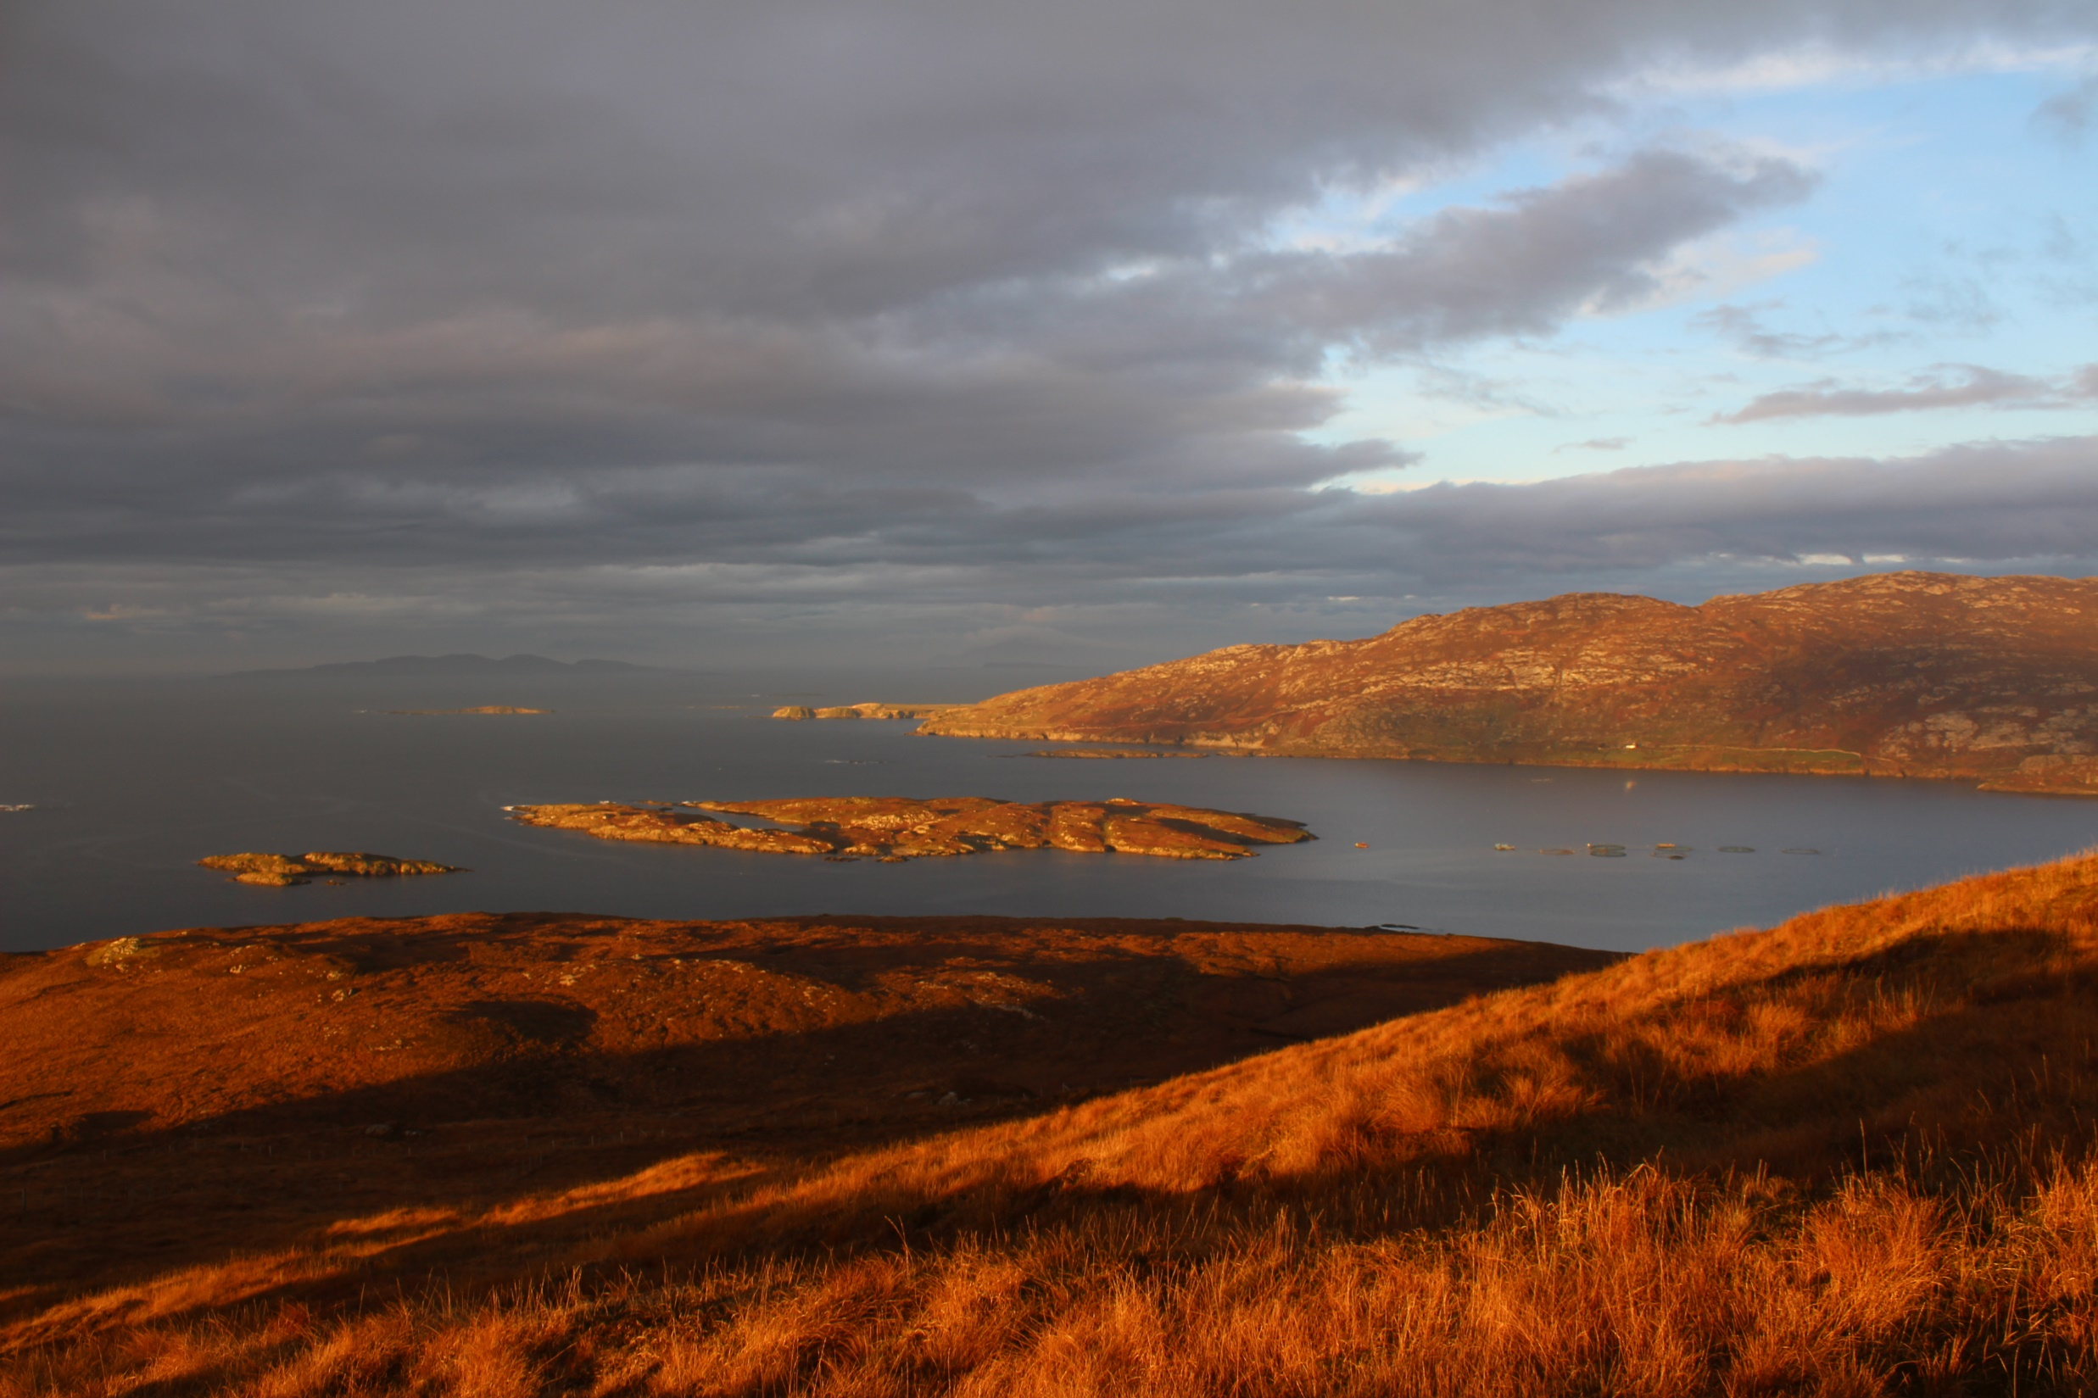
Evening Talk Exploring the Archaeology of Aughrus, Ballynakill & Claddaghduff.
Friday December 28th 2018 Claddaghduff Hall at 7pm
Michael Gibbons, MIAI

